Slide 1
Reactions in geochemical systems: thermodynamics and phase diagram principles
EART26201 | Principles of Geochemistry | Lecture 3
Part 1 | Introduction

Slide 2
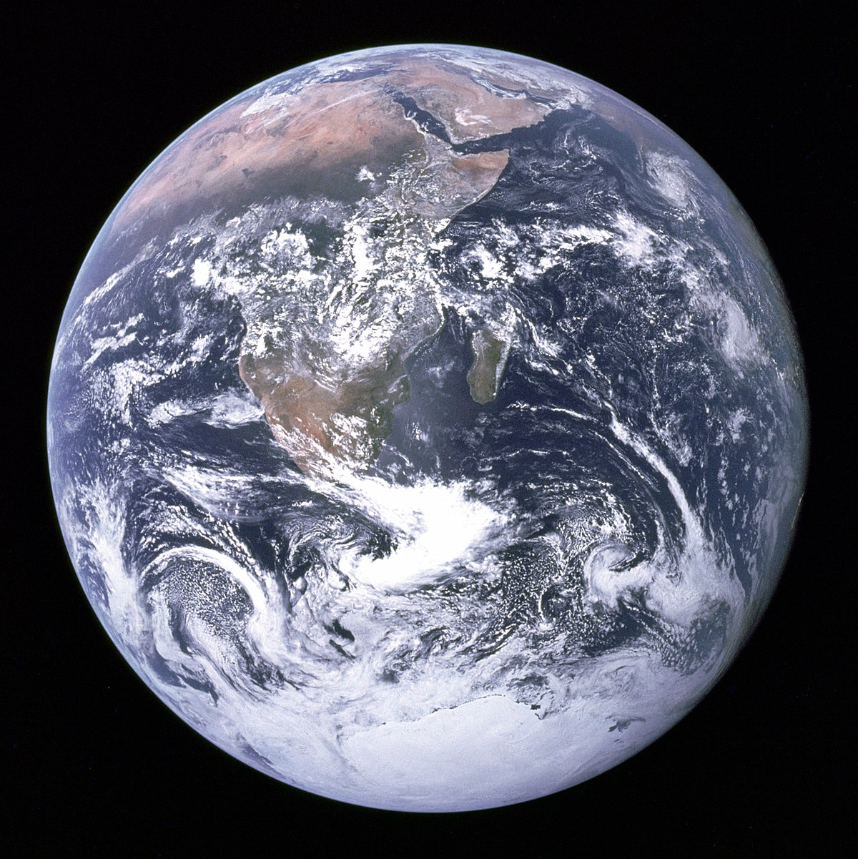
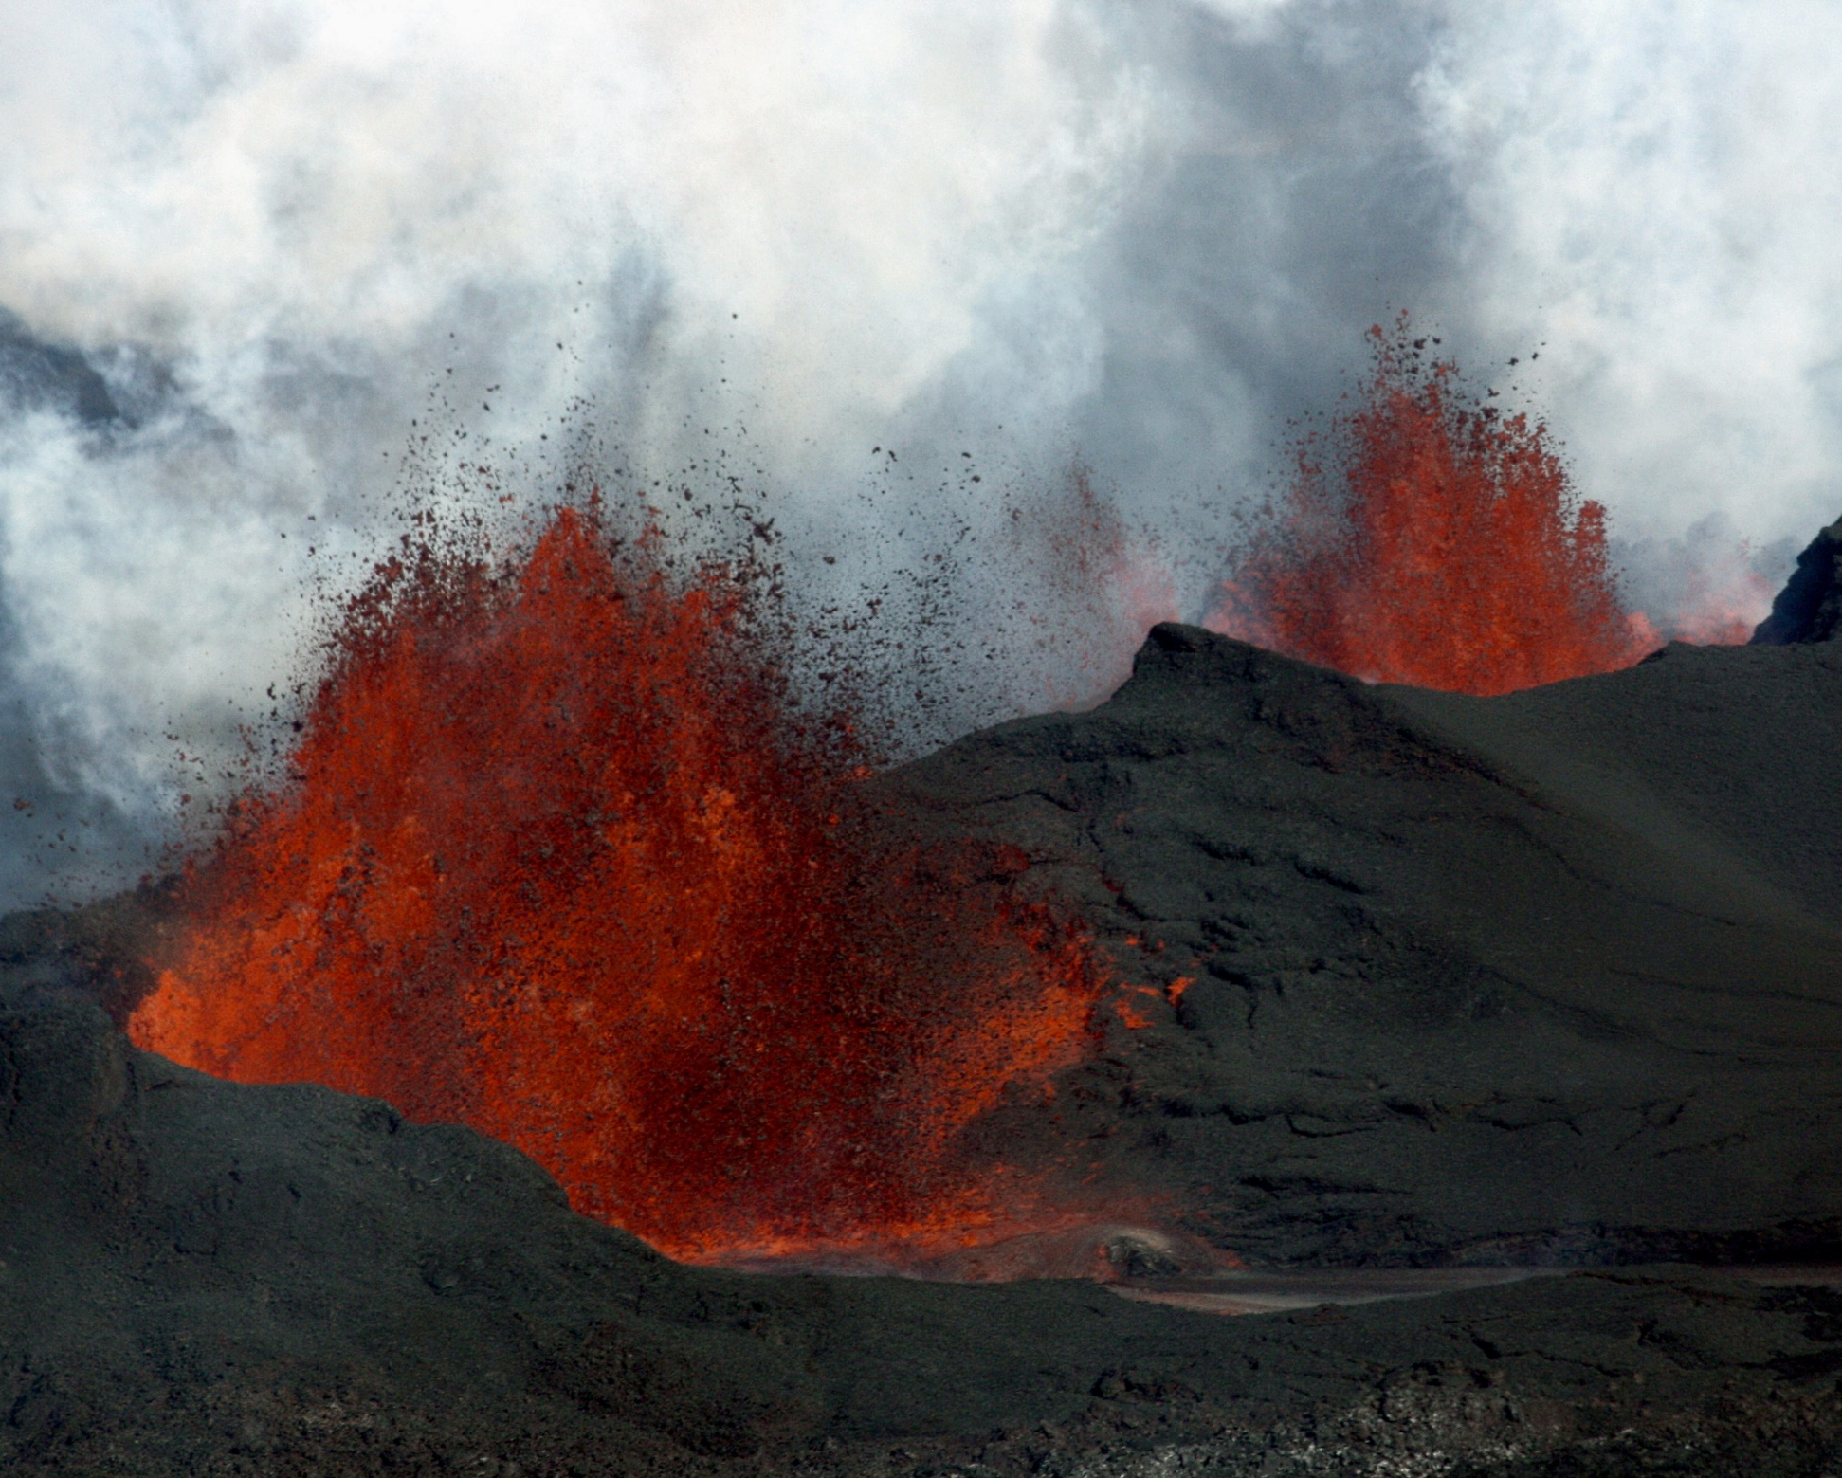
Variations in pressure, temperature and composition
credit: NASA
Holuhraun, Iceland, credit: Fangorn9

Slide 3
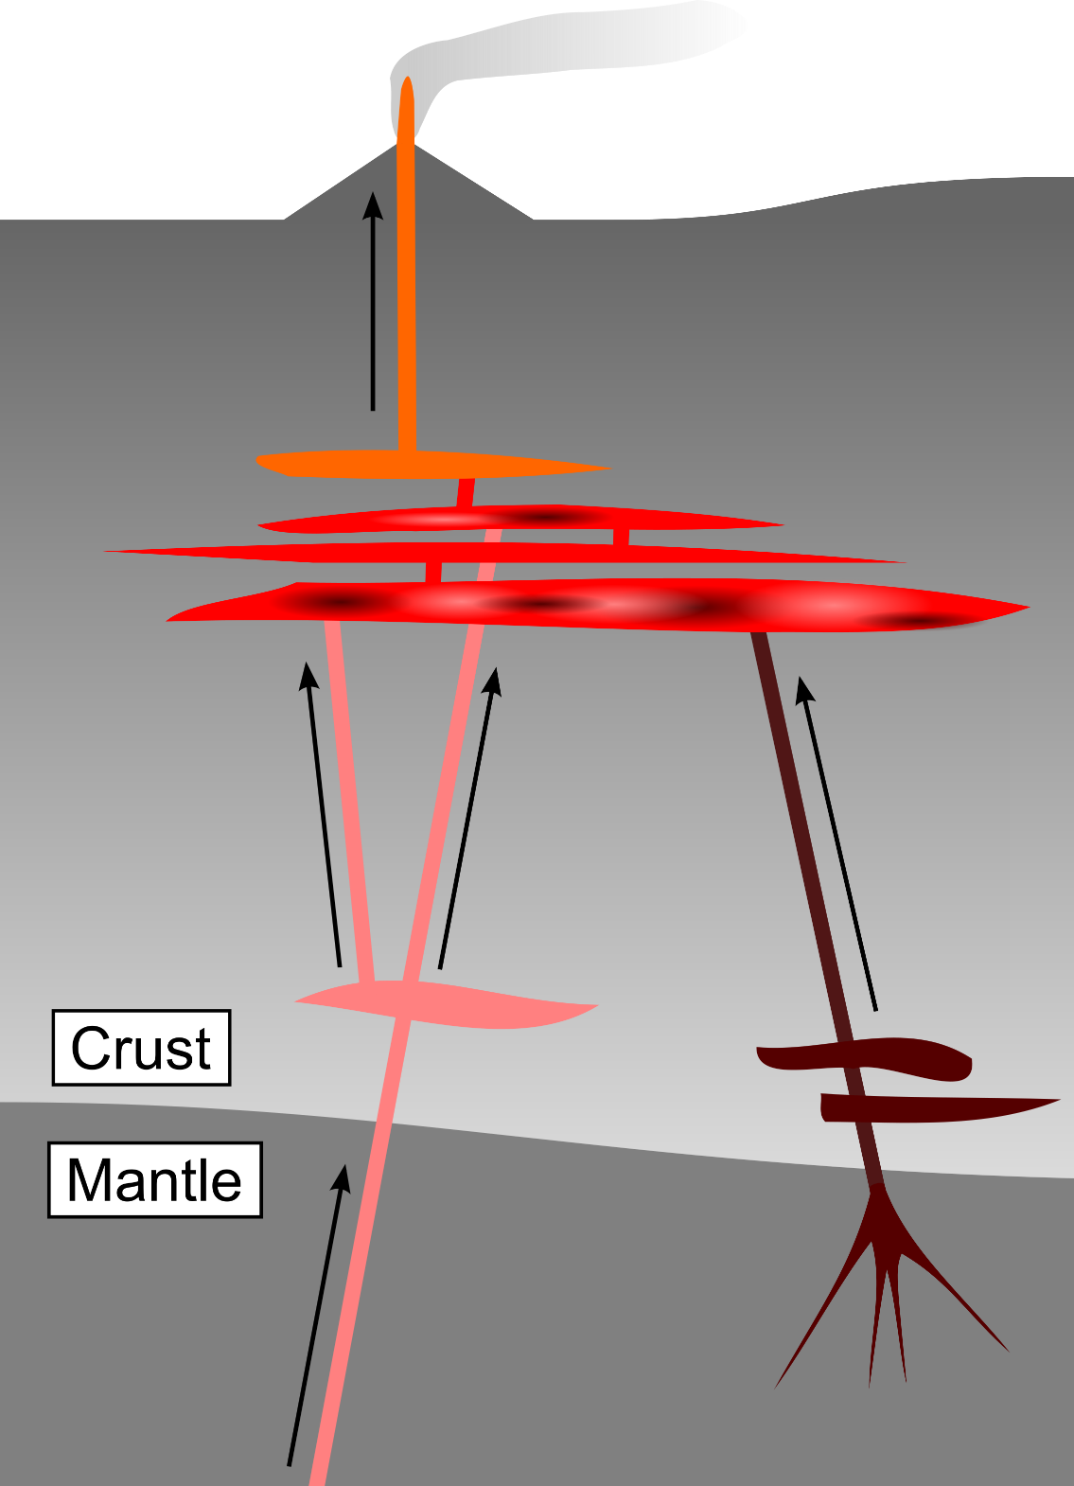
Equilibrium in Earth systems: from mantle to surface
Equilibrium is reached when constituents of a system do not change with time
At equilibrium, basaltic magmas are liquid under mantle conditions, but…
…solid under surface conditions
Crystallisation reflects the re-equilibration of hot magmas with cooler surroundings
Thermodynamics lets us quantitatively describe chemical changes in the Earth

Slide 4
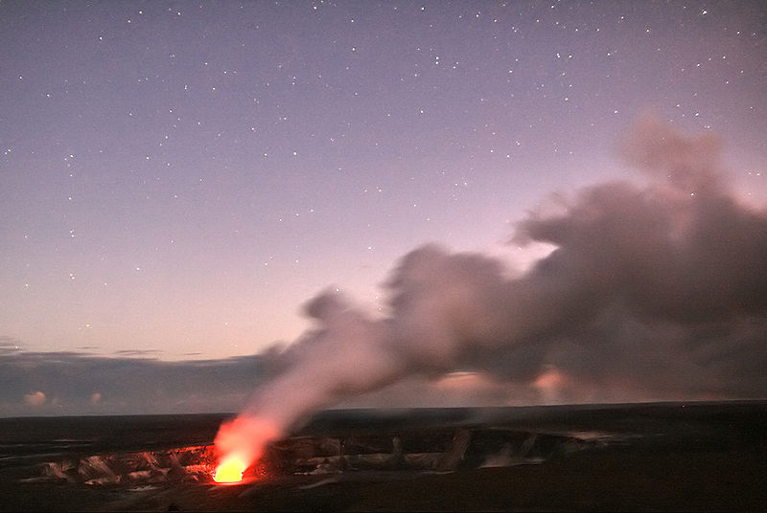
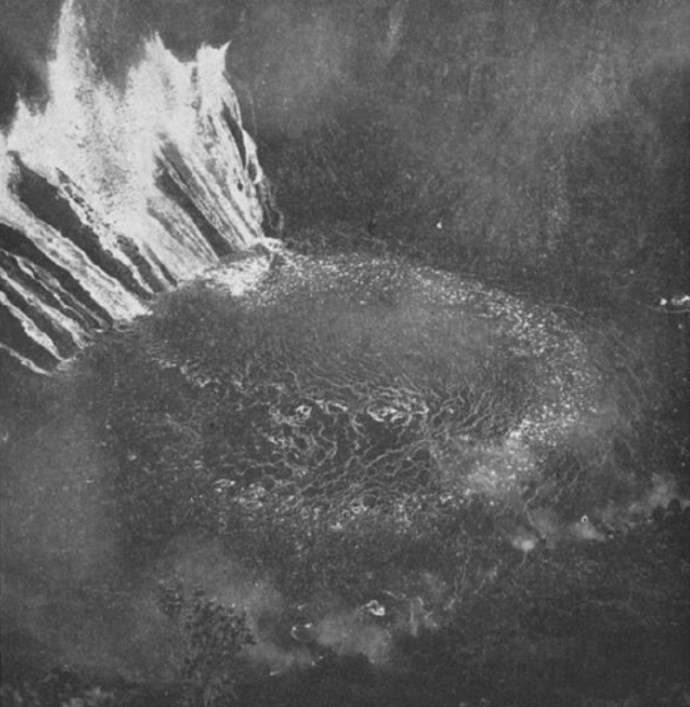
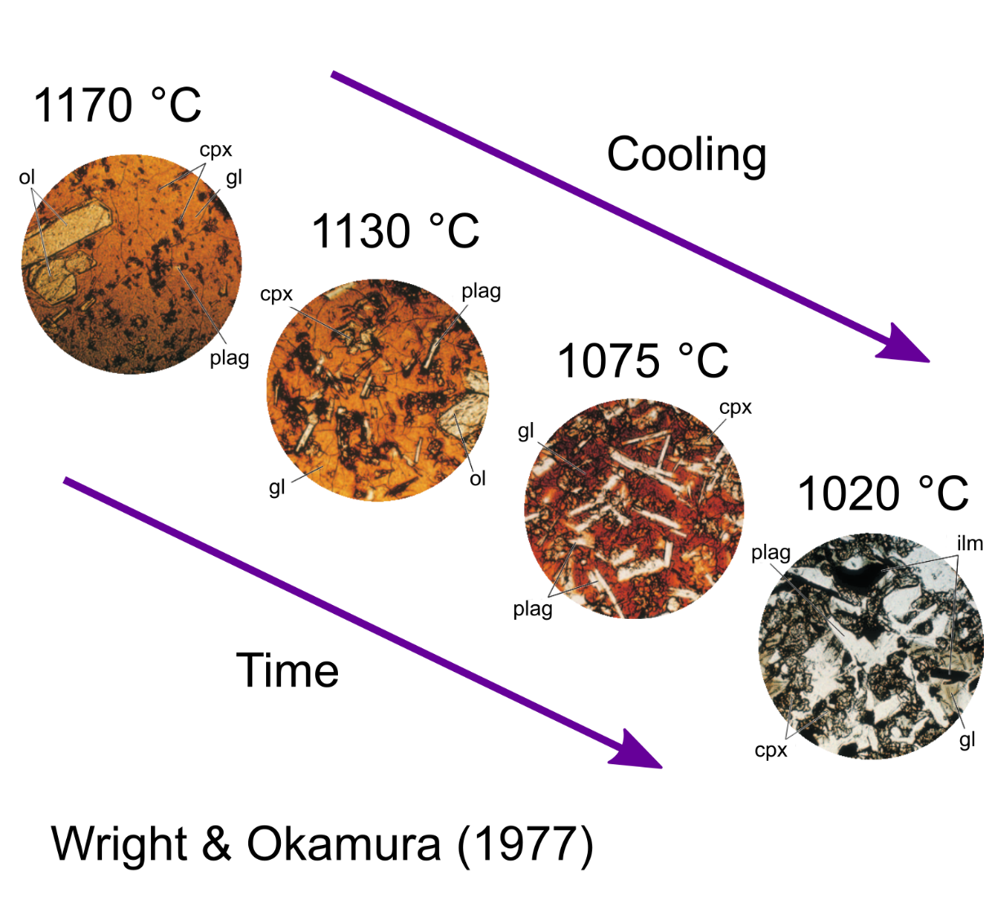
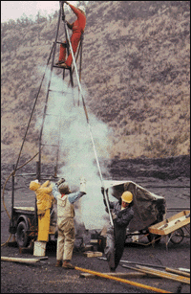
Equilibrium in Earth systems: magma crystallisation
Out of equilibrium: Halemaʻumaʻu lava lake in Hawaii before the 2018 eruption
Approaching equilibrium: crystallisation of the Makaopuhi lava lake in 1965
Halemaʻumaʻu, Hawaii, credit: Brocken Inaglory
Wright & Okamura (1977)
credit: USGS

Slide 5
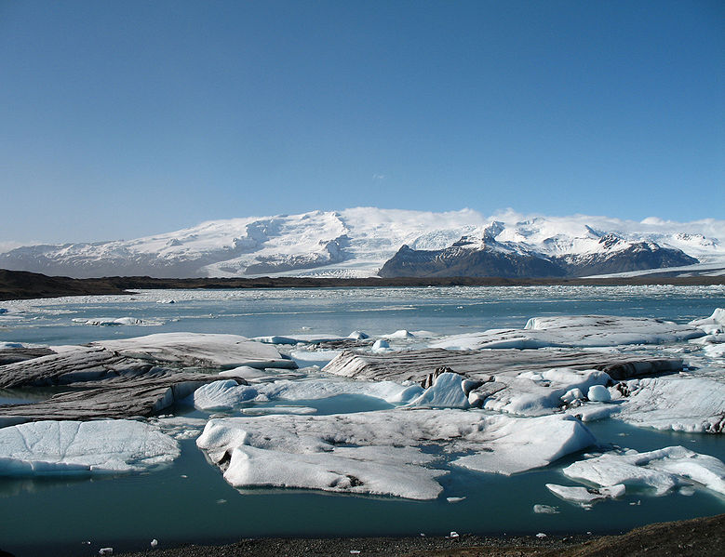
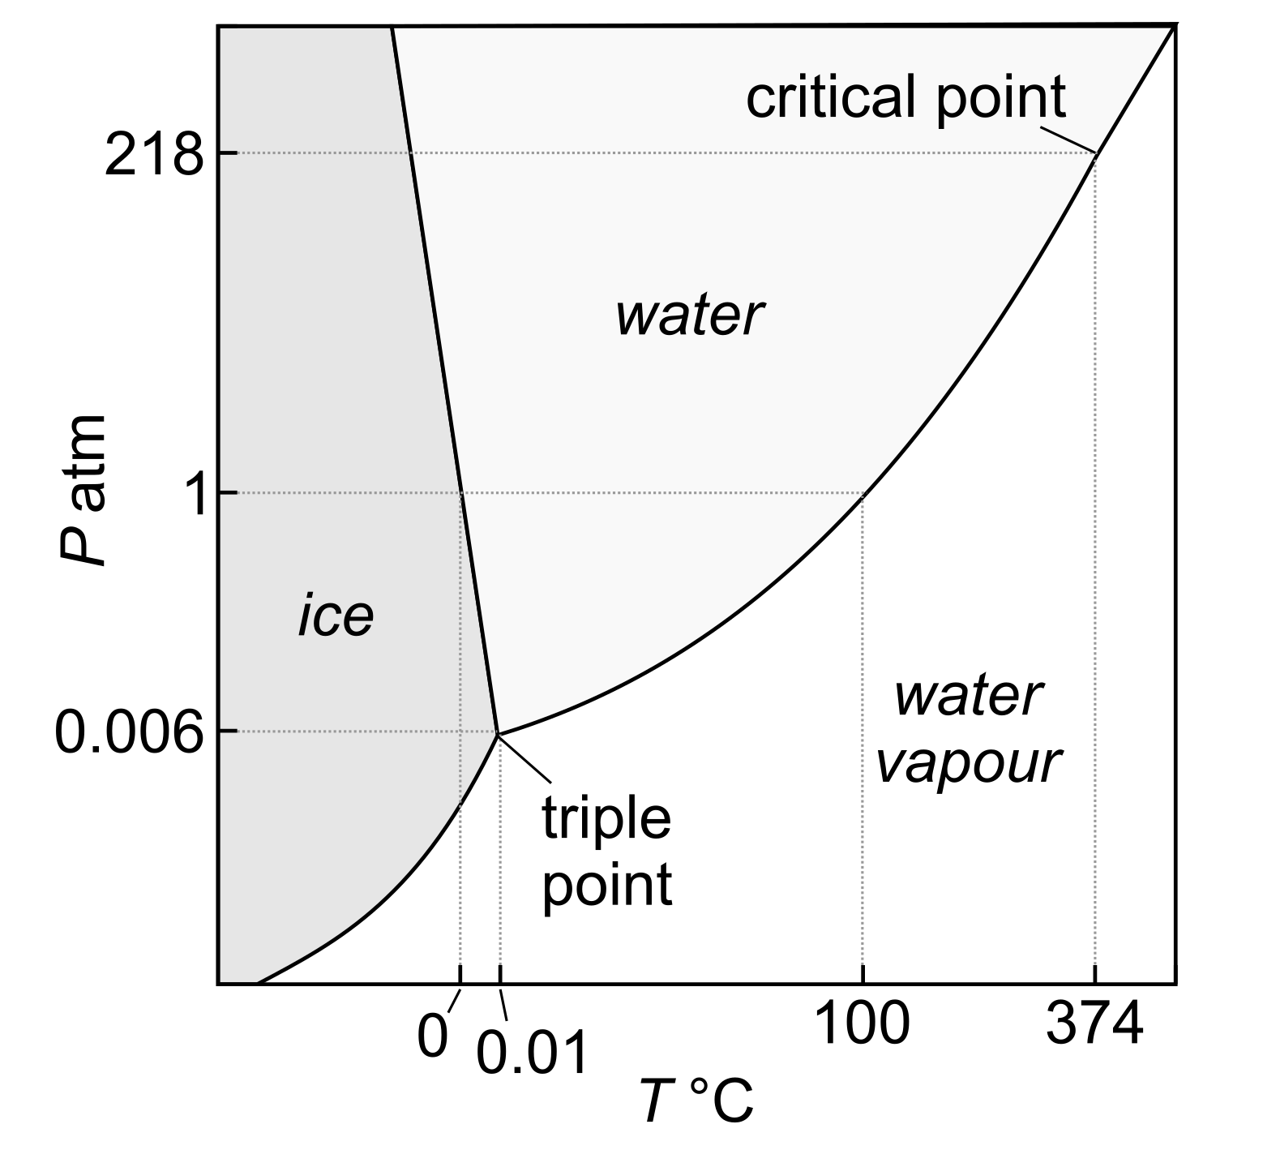
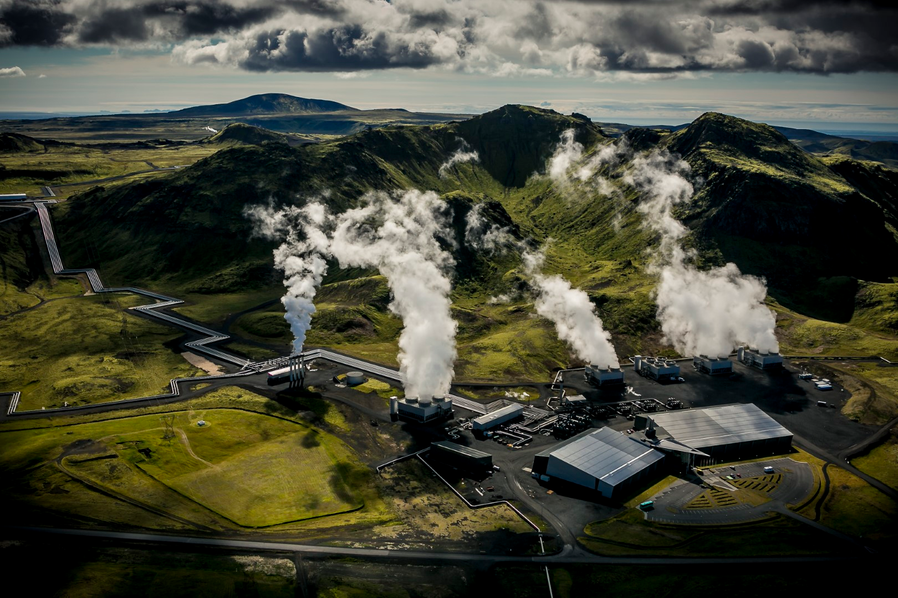
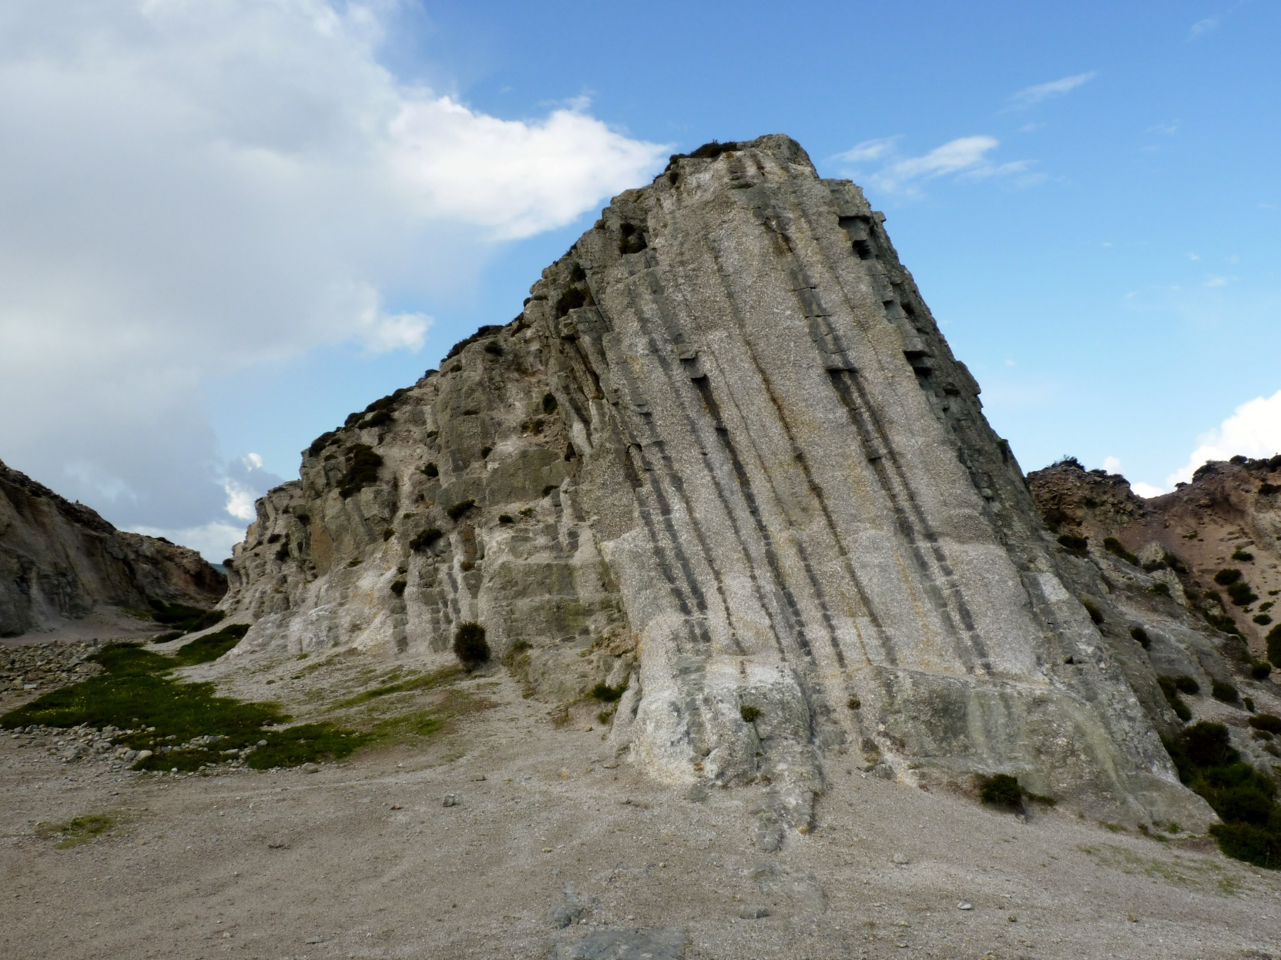


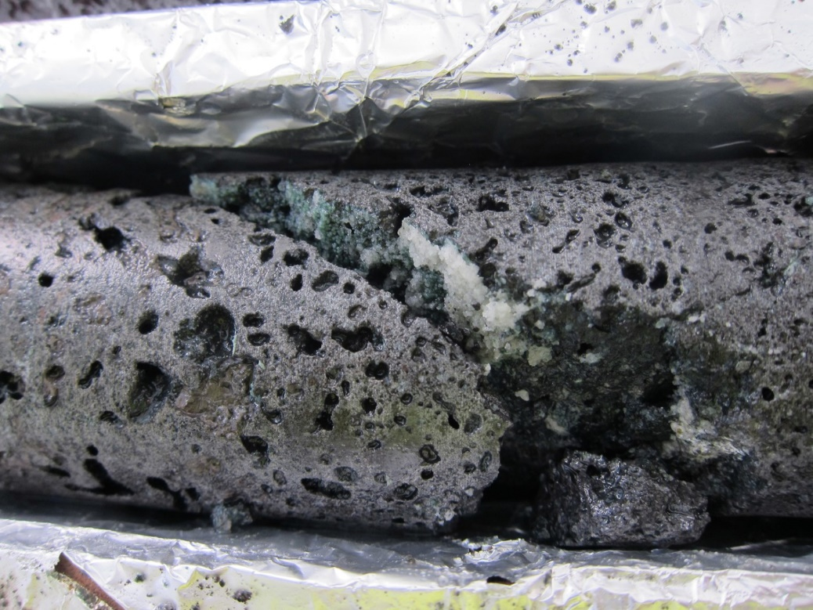
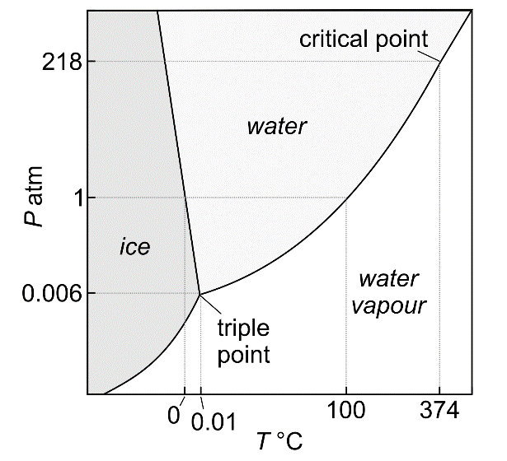


The importance of thermodynamics in Earth science
Predictive power: forecast responses to changing conditions
Applications: from prospecting to geoengineering and carbon capture
Cligga Head, Cornwall: tin and tungsten mine
Jökulsárlón, Iceland, credit: Martin Peeks
Carbfix project, Iceland

Slide 6
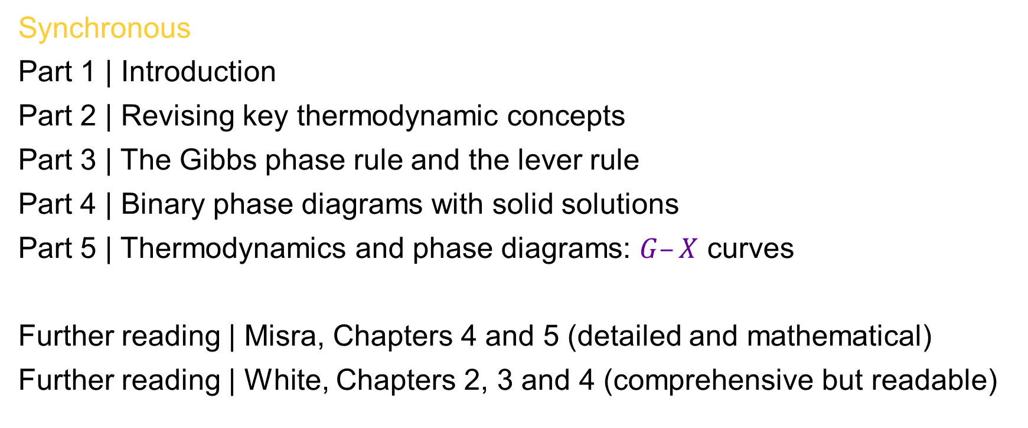
Lecture 3 synopsis
Synchronous
Part 1 | Introduction
Part 2 | Revising key thermodynamic concepts
Part 3 | The Gibbs phase rule and the lever rule
Part 4 | Binary phase diagrams with solid solutions
Part 5 | Thermodynamics and phase diagrams: $G–X$ curves
Further reading | Misra, Chapters 4 and 5 (detailed and mathematical)
Further reading | White, Chapters 2, 3 and 4 (comprehensive but readable)

Slide 7
Reactions in geochemical systems: thermodynamics and phase diagram principles
EART26201 | Principles of Geochemistry | Lecture 3
Part 2 | Key thermodynamic concepts

Slide 8
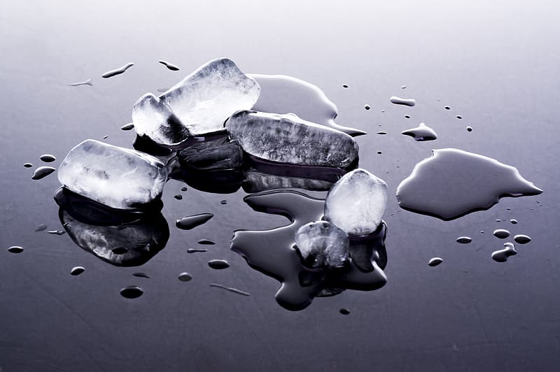
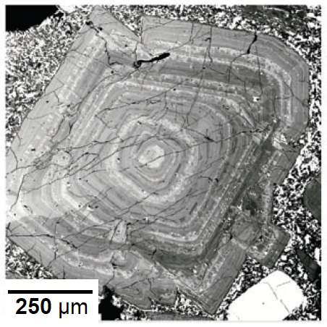
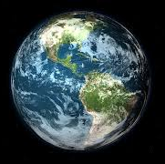
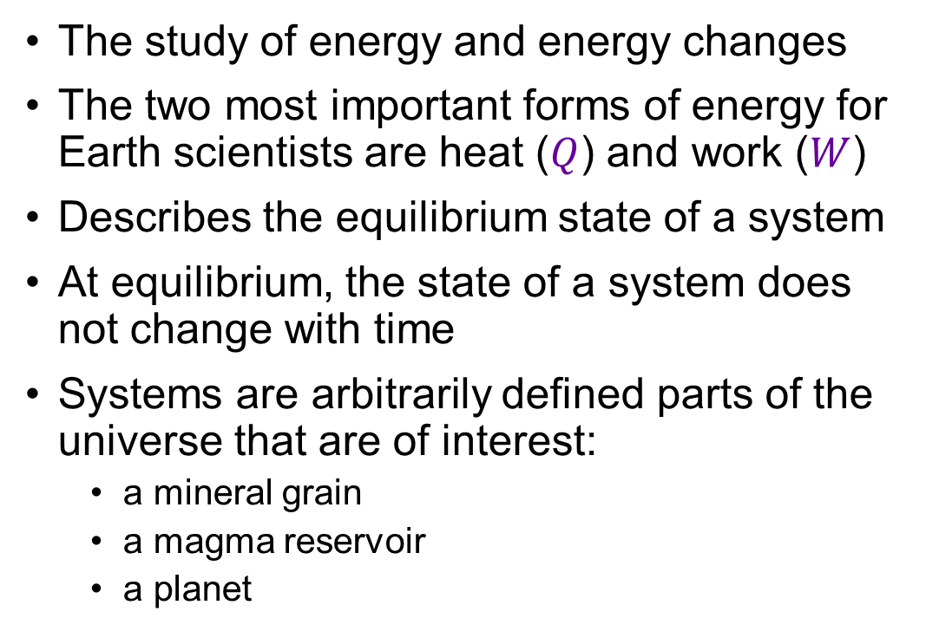
Thermodynamics
The study of energy and energy changes
The two most important forms of energy for Earth scientists are heat ($Q$) and work ($W$)
Describes the equilibrium state of a system
At equilibrium, the state of a system does not change with time
Systems are arbitrarily defined parts of the universe that are of interest:
  a mineral grain
  a magma reservoir
  a planet

Slide 9
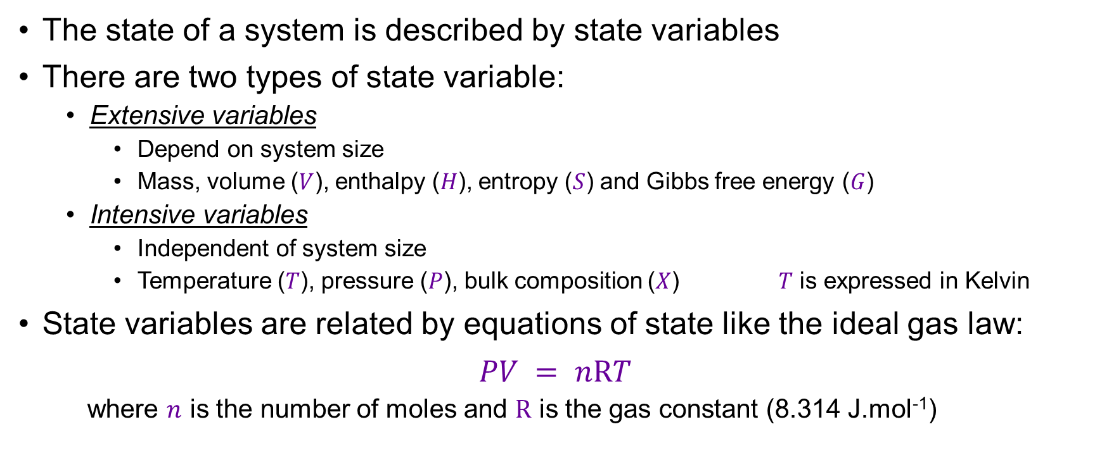
State variables and equations of state
The state of a system is described by state variables
There are two types of state variable:
  Extensive variables
    Depend on system size
    Mass, volume ($V$), enthalpy ($H$), entropy ($S$) and Gibbs free energy ($G$)
  Intensive variables
    Independent of system size
    Temperature ($T$), pressure ($P$), bulk composition ($X$) $T$ is expressed in Kelvin
State variables are related by equations of state like the ideal gas law:
$$PV = n\text{R}T$$
  where $n$ is the number of moles and $\text{R}$ is the gas constant (8.314 J.mol⁻¹)
We will use symbols to discuss and apply thermodynamics, but I do not expect you to memorise them!

Slide 10
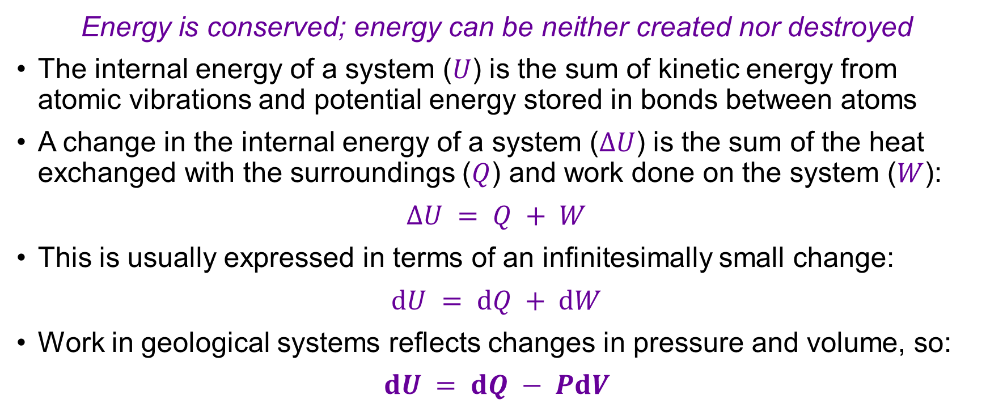
First law of thermodynamics
Energy is conserved; energy can be neither created nor destroyed
The internal energy of a system ($U$) is the sum of kinetic energy from atomic vibrations and potential energy stored in bonds between atoms
A change in the internal energy of a system ($ΔU$) is the sum of the heat exchanged with the surroundings ($Q$) and work done on the system ($W$):
$$ΔU = Q + W$$
This is usually expressed in terms of an infinitesimally small change:
$$dU = dQ + dW$$
Work in geological systems reflects changes in pressure and volume, so:
$$dU = dQ − PdV$$
See the summary of key symbols

Slide 11
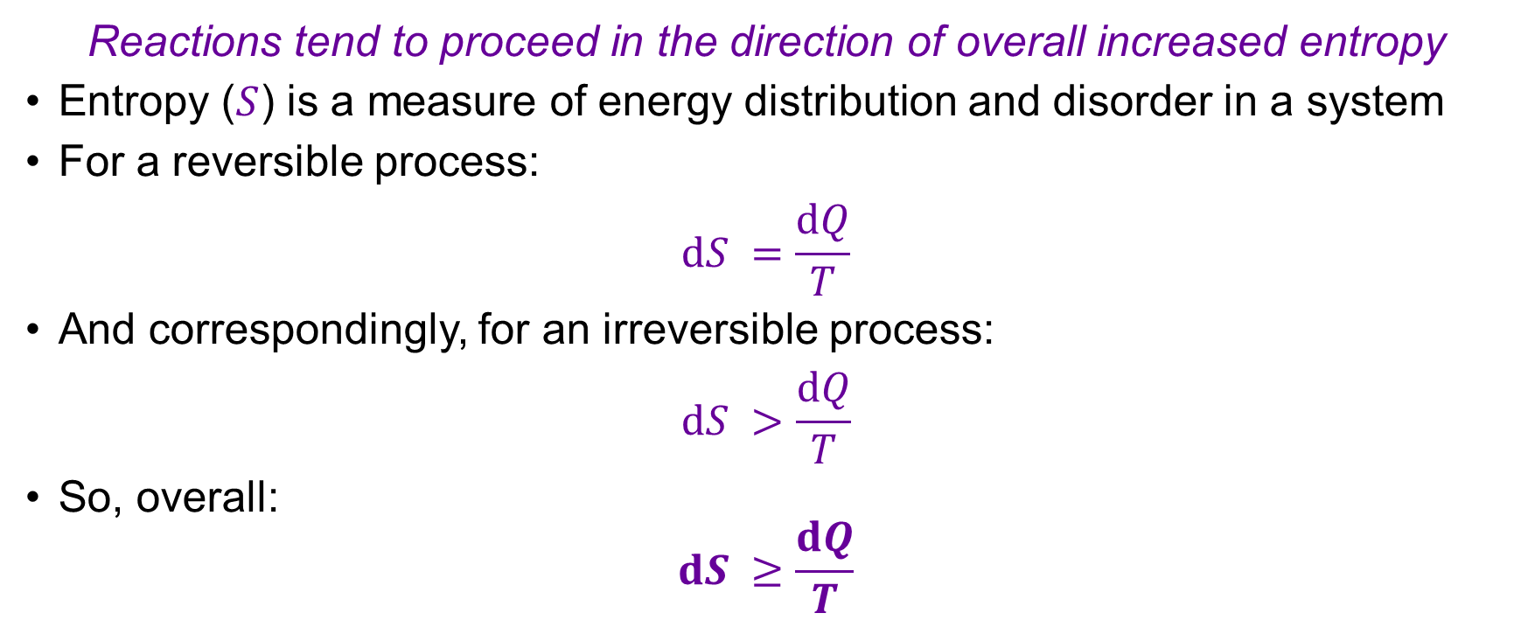
Second law of thermodynamics
Reactions tend to proceed in the direction of overall increased entropy
Entropy ($S$) is a measure of energy distribution and disorder in a system
For a reversible process:
$$dS =\frac{dQ}{T}$$
And correspondingly, for an irreversible process:
$$dS >\frac{dQ}{T}$$
So, overall:
$$dS ≥\frac{dQ}{T}$$

Slide 12
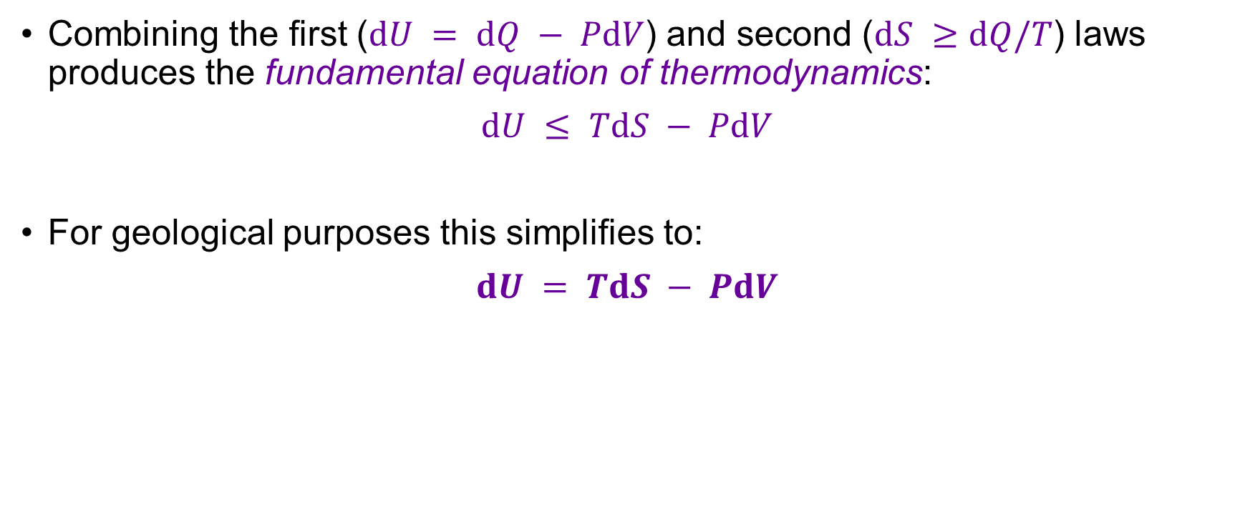
Combining the first and second laws
Combining the first ($dU = dQ − PdV$) and second ($dS ≥dQ/T$) laws produces the fundamental equation of thermodynamics:
$$dU ≤ TdS − PdV$$
For geological purposes this simplifies to:
$$dU = TdS − PdV$$
Change in internal energy
Heat exchanged with surroundings
Physical movement in space

Slide 13
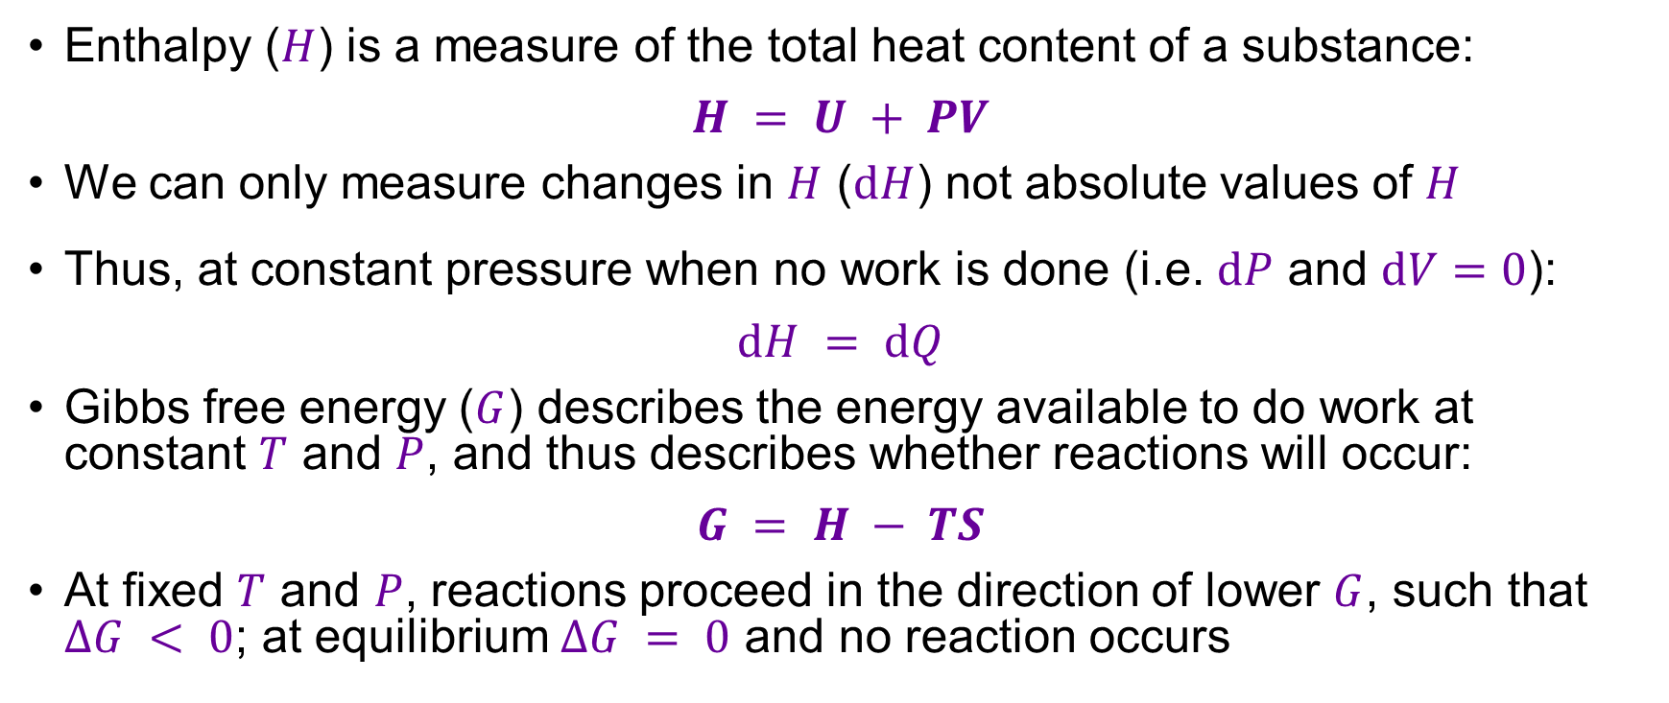
Enthalpy and Gibbs free energy
Enthalpy ($H$) is a measure of the total heat content of a substance:
$$H = U + PV$$
We can only measure changes in $H$ ($dH$) not absolute values of $H$
Thus, at constant pressure when no work is done (i.e. $dP$ and $dV=0$):
$$dH = dQ$$
Gibbs free energy ($G$) describes the energy available to do work at constant $T$ and $P$, and thus describes whether reactions will occur:
$$G = H − TS$$
At fixed $T$ and $P$, reactions proceed in the direction of lower $G$, such that $ΔG < 0$; at equilibrium $ΔG = 0$ and no reaction occurs
This should be familiar from Chemistry of the Earth

Slide 14
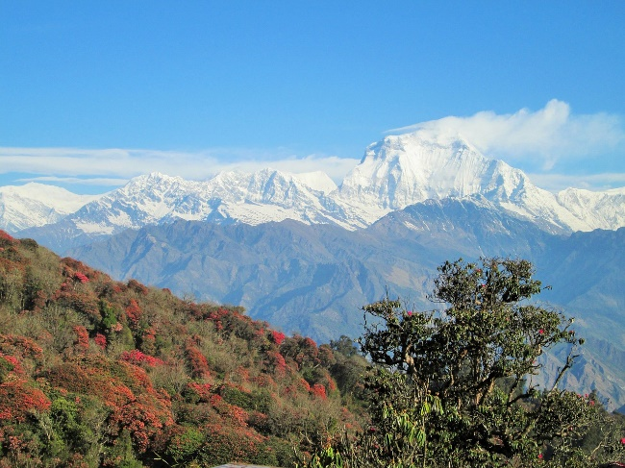
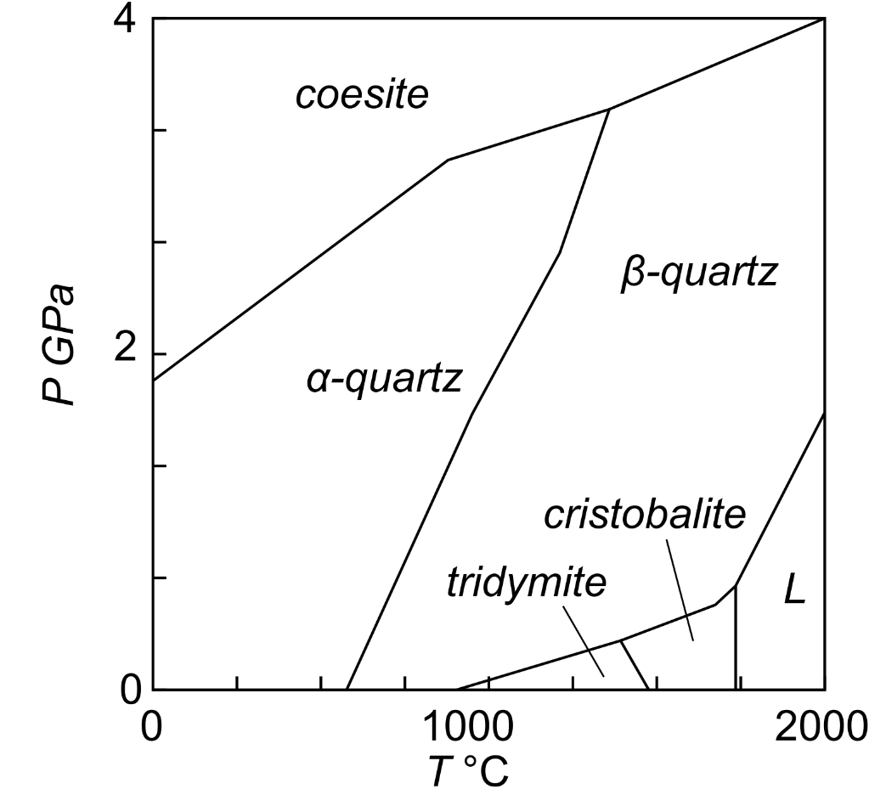
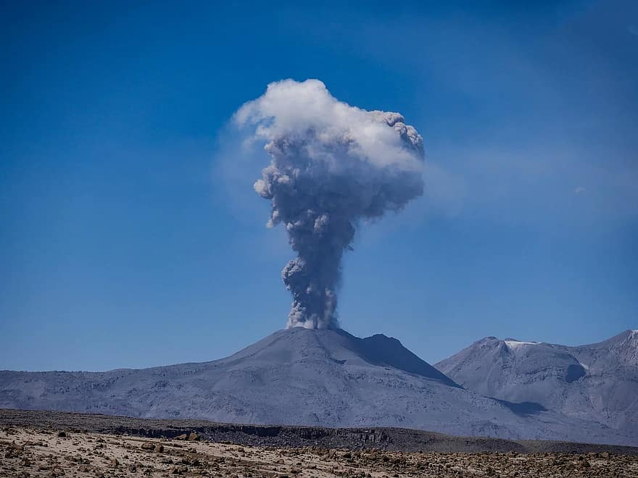
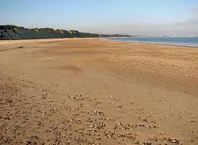
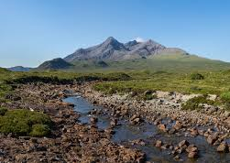
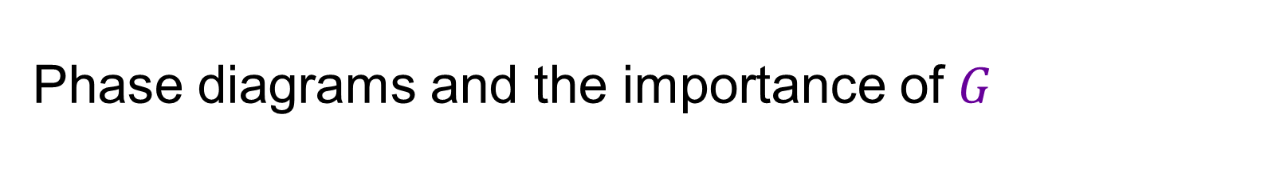
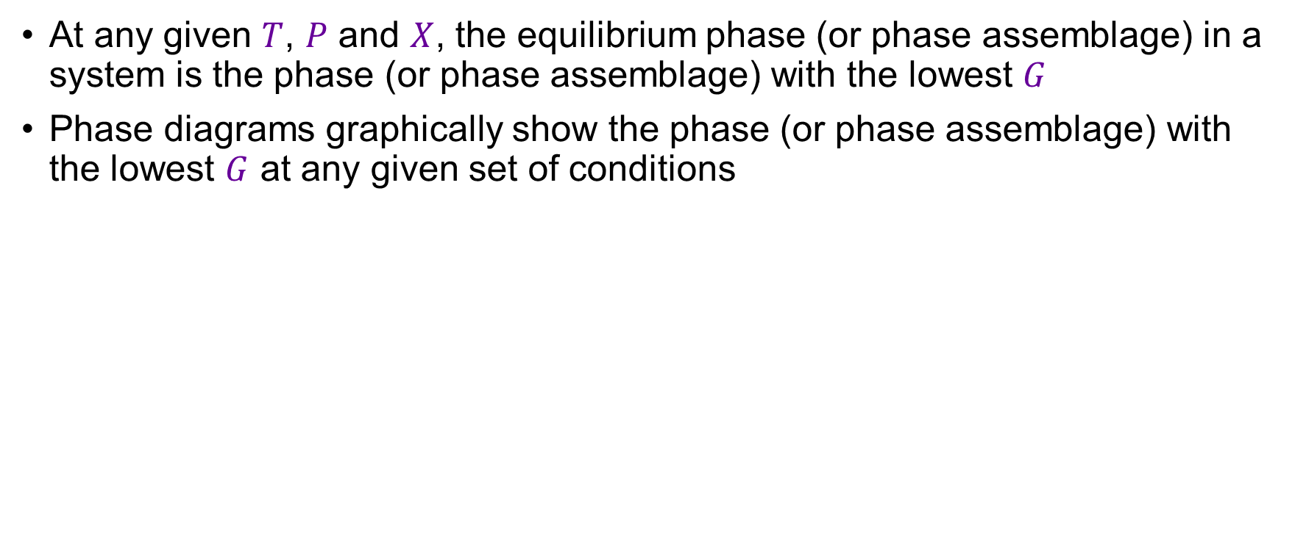
Phase diagrams and the importance of $G$
At any given $T$, $P$ and $X$, the equilibrium phase (or phase assemblage) in a system is the phase (or phase assemblage) with the lowest $G$
Phase diagrams graphically show the phase (or phase assemblage) with the lowest $G$ at any given set of conditions

Slide 15
Reactions in geochemical systems: thermodynamics and phase diagram principles
EART26201 | Principles of Geochemistry | Lecture 3
Part 3 | The Gibbs phase rule and the lever rule

Slide 16
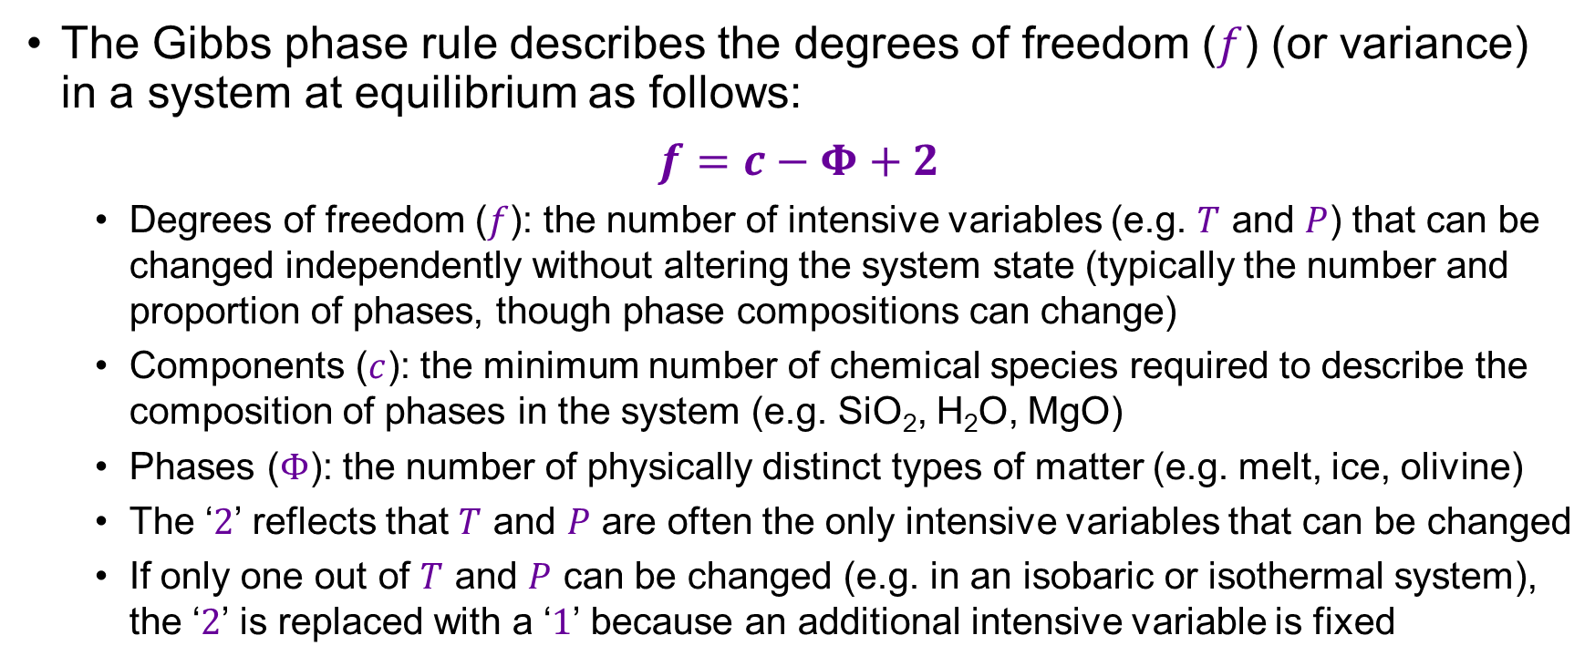
The Gibbs phase rule
The Gibbs phase rule describes the degrees of freedom ($f$) (or variance) in a system at equilibrium as follows:
$$f=c−Φ+2$$
  Degrees of freedom ($f$): the number of intensive variables (e.g. $T$ and $P$) that can be changed independently without altering the system state (typically the number and proportion of phases, though phase compositions can change)
  Components ($c$): the minimum number of chemical species required to describe the composition of phases in the system (e.g. SiO₂, H₂O, MgO)
  Phases ($Φ$): the number of physically distinct types of matter (e.g. melt, ice, olivine)
  The ‘$2$’ reflects that $T$ and $P$ are often the only intensive variables that can be changed
  If only one out of $T$ and $P$ can be changed (e.g. in an isobaric or isothermal system), the ‘$2$’ is replaced with a ‘$1$’ because an additional intensive variable is fixed

Slide 17
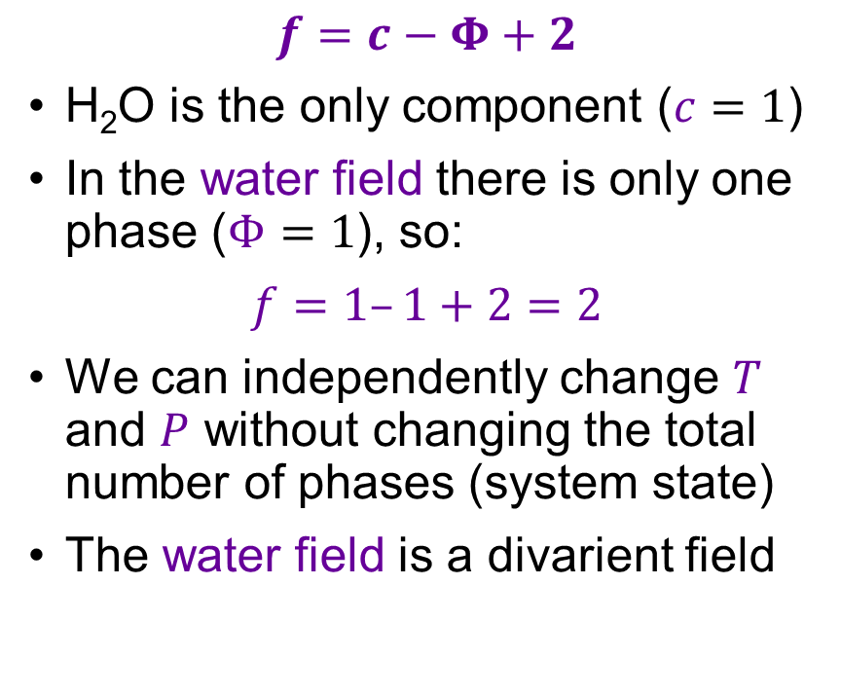
The Gibbs phase rule: H₂O phase diagram
$$f=c−Φ+2$$
H₂O is the only component ($c=1$)
In the water field there is only one phase ($Φ=1$), so:
$$f=1–1+2=2$$
We can independently change $T$ and $P$ without changing the total number of phases (system state)
The water field is a divarient field

Slide 18
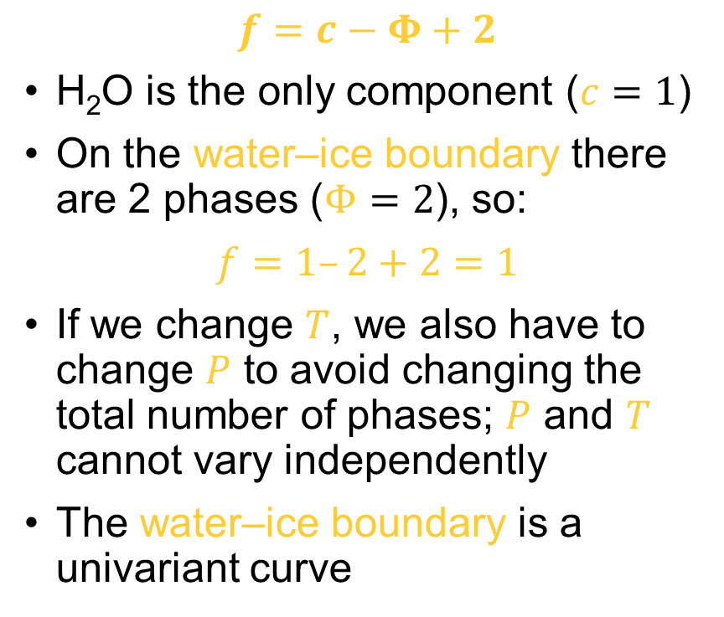
The Gibbs phase rule: H₂O phase diagram
$$f=c−Φ+2$$
H₂O is the only component ($c=1$)
On the water–ice boundary there are 2 phases ($Φ=2$), so:
$$f=1–2+2=1$$
If we change $T$, we also have to change $P$ to avoid changing the total number of phases; $P$ and $T$ cannot vary independently
The water–ice boundary is a univariant curve

Slide 19
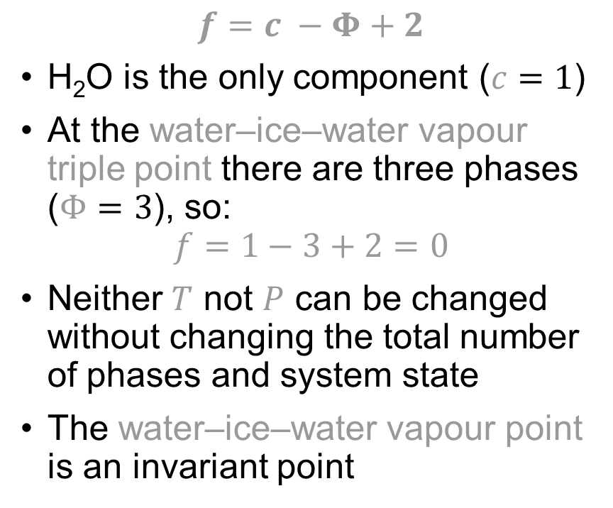
The Gibbs phase rule: H₂O phase diagram
$$f=c −Φ+2$$
H₂O is the only component ($c=1$)
At the water–ice–water vapour triple point there are three phases ($Φ=3$), so:
$$f=1−3+2=0$$
Neither $T$ not $P$ can be changed without changing the total number of phases and system state
The water–ice–water vapour point is an invariant point

Slide 20
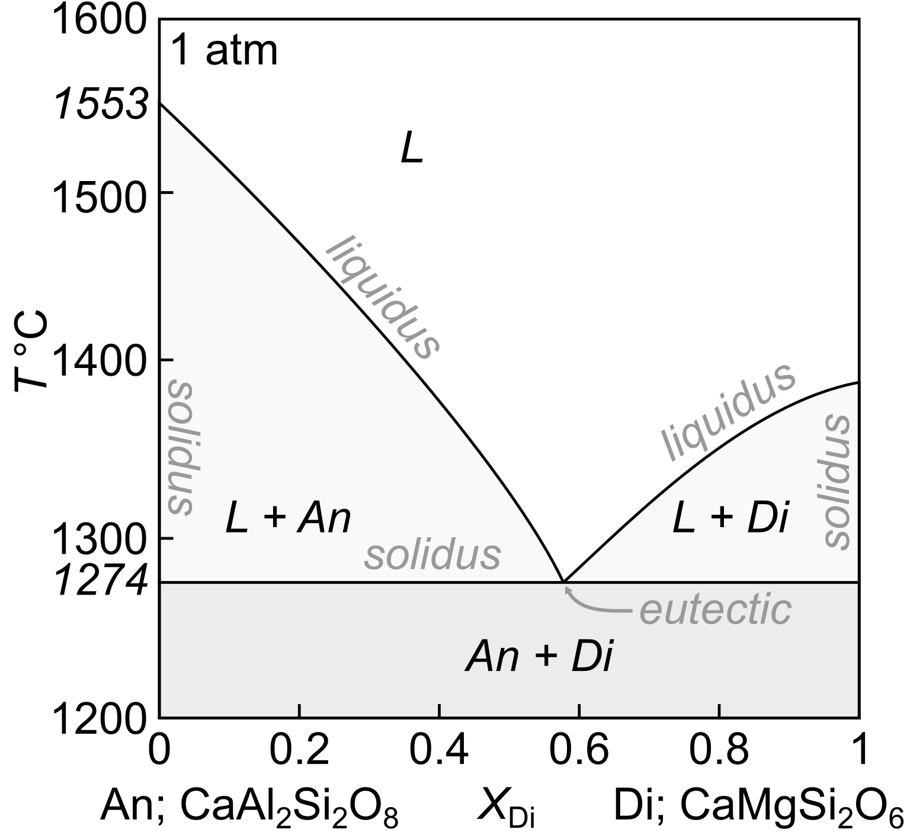
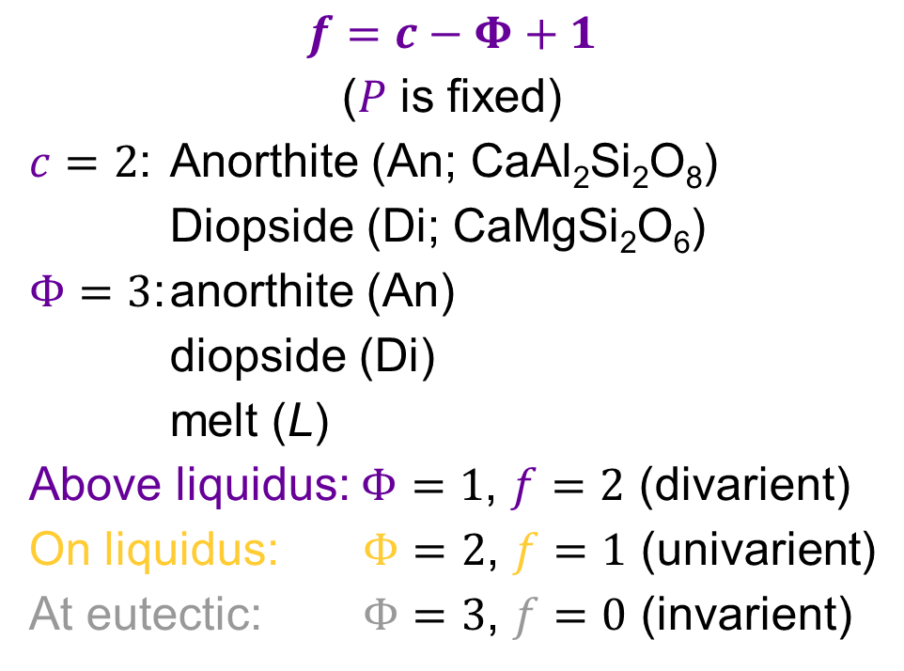
The Gibbs phase rule: isobaric An–Di phase diagram
$$f=c−Φ+1$$
($P$ is fixed)
$c=2$: Anorthite (An; CaAl₂Si₂O₈)
Diopside (Di; CaMgSi₂O₆)
$Φ=3$: anorthite (An)
diopside (Di)
melt (L)
Above liquidus: $Φ=1$, $f=2$ (divarient)
On liquidus: $Φ=2$, $f=1$ (univarient)
At eutectic: $Φ=3$, $f=0$ (invarient)
L
An
We’ll look at this phase diagram again in Lecture 4

Slide 21
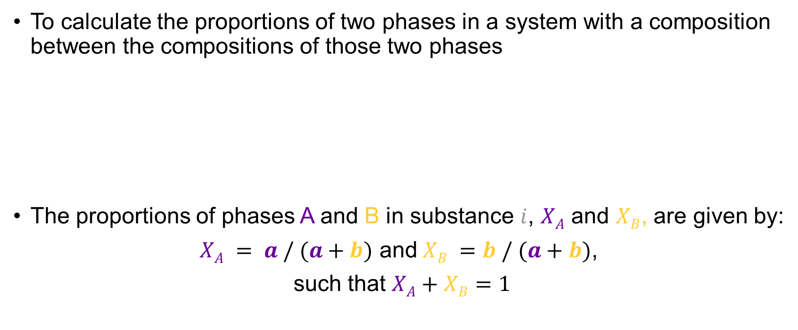



The lever rule
To calculate the proportions of two phases in a system with a composition between the compositions of those two phases
The proportions of phases A and B in substance $i$, $XA$ and $XB$, are given by:
$XA = a / (a+b)$ and$XB =b / (a+b)$,
such that $XA+XB=1$
Phase A
$$i$$
Phase B
$$b$$
$$a$$
Expressed in wt.% or mol.%

Slide 22
Reactions in geochemical systems: thermodynamics and phase diagram principles
EART26201 | Principles of Geochemistry | Lecture 3
Part 4 | Binary phase diagrams with solid solutions

Slide 23
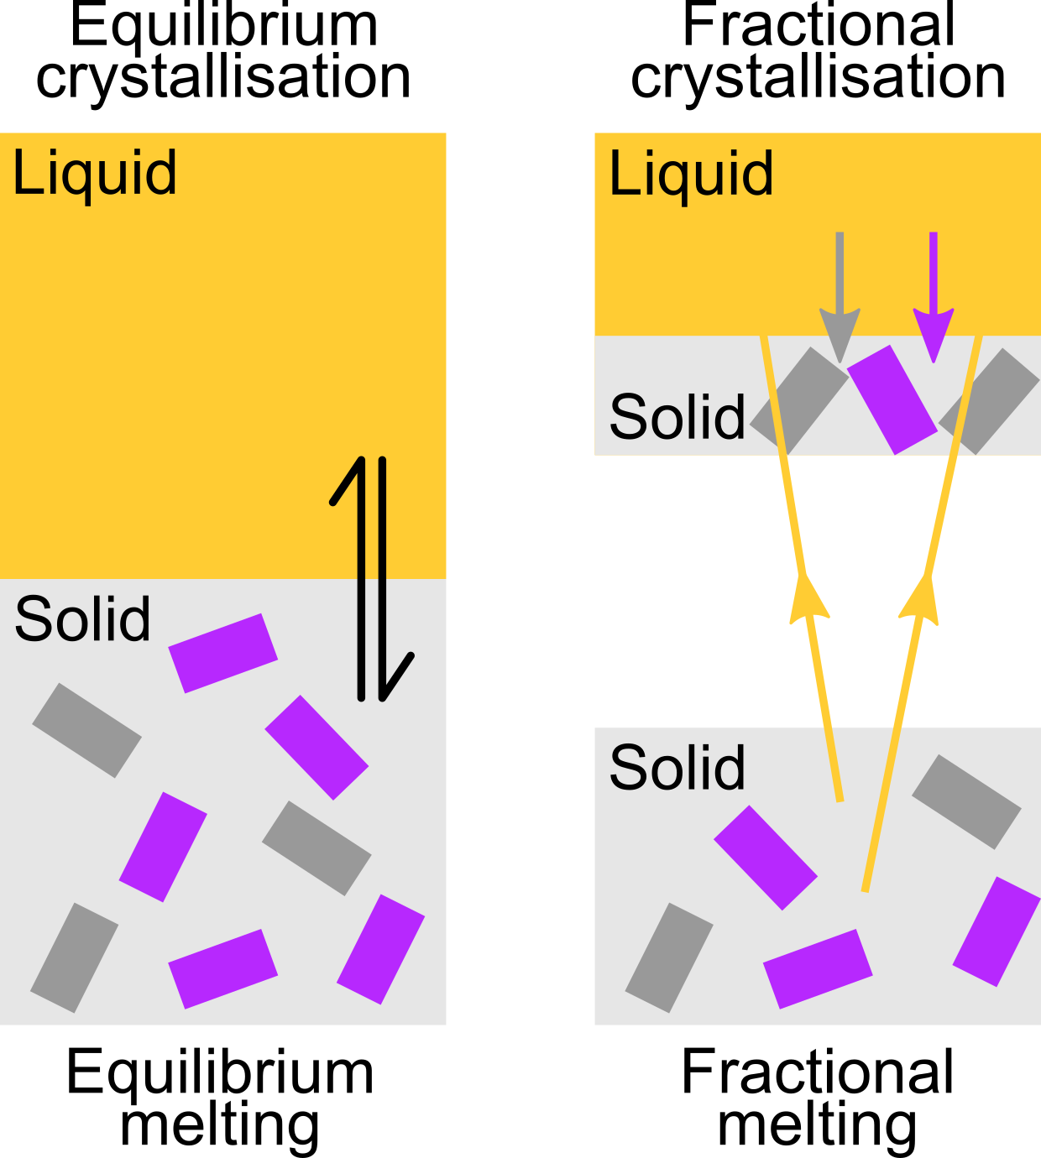
Equilibrium and fractional processes
Equilibrium melting and crystallisation
Solid and liquid remain in equilibrium with each other
Fractional melting
As liquids are formed, they are removed and are no longer in equilibrium with the solid
Fractional crystallisation
As solids are formed, they are removed and are no longer in equilibrium with the liquid

Slide 24
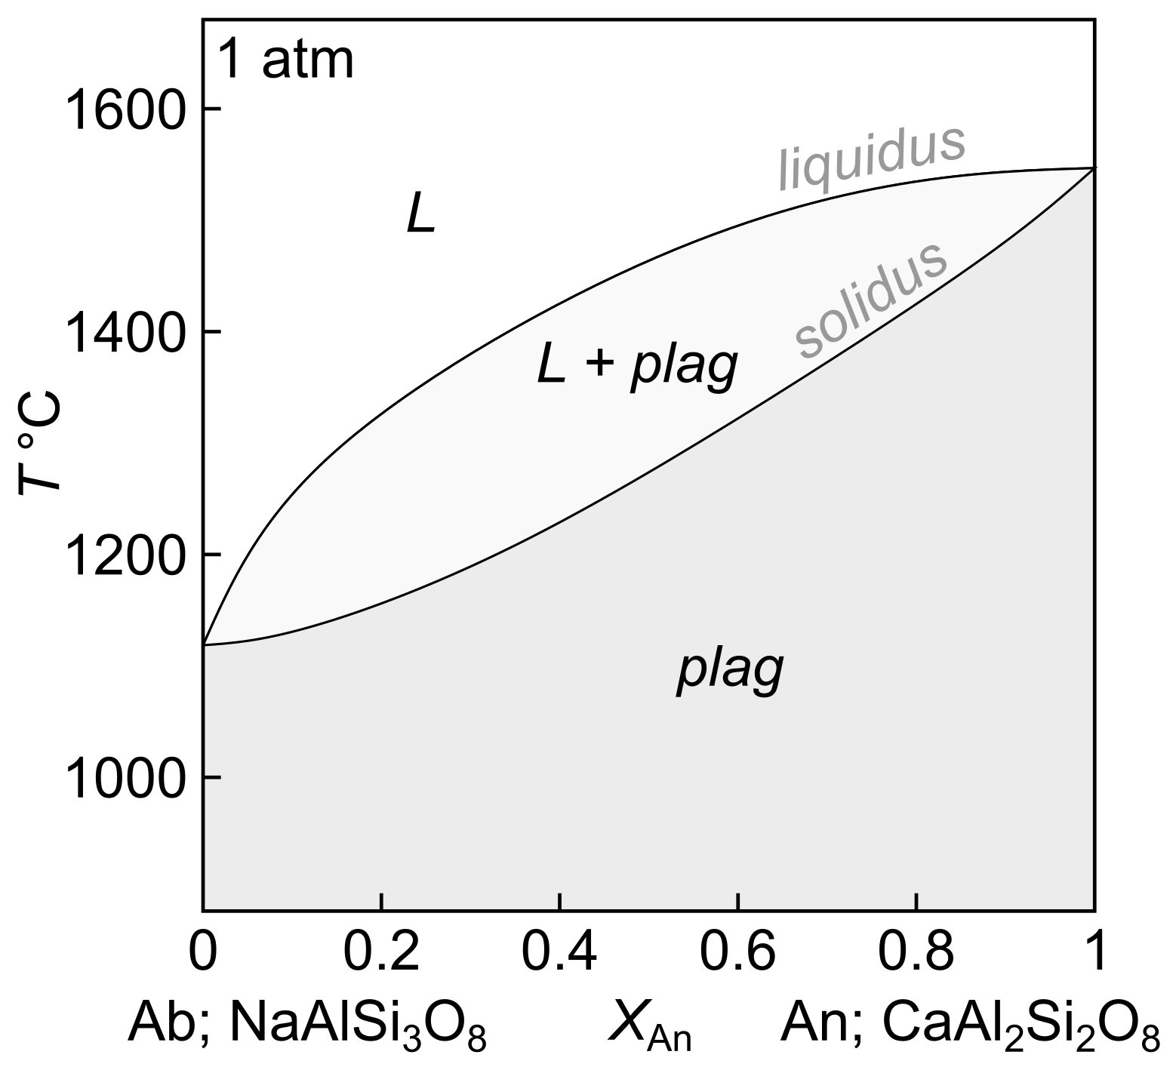
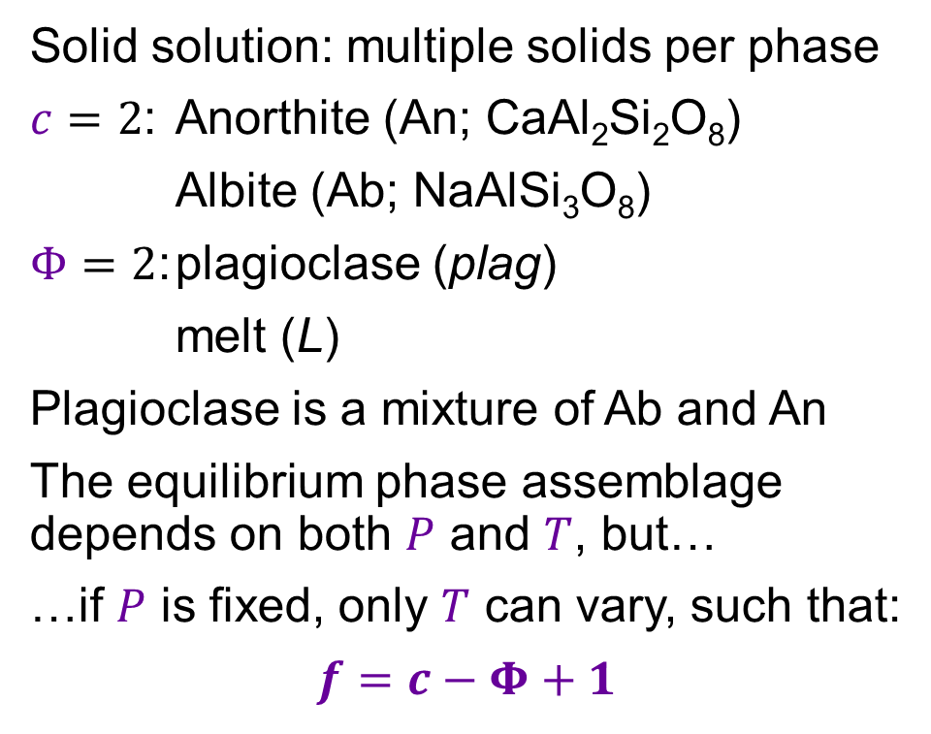
Binary phase diagram with solid solution: plagioclase
Solid solution: multiple solids per phase
$c=2$: Anorthite (An; CaAl₂Si₂O₈)
Albite (Ab; NaAlSi₃O₈)
$Φ=2$: plagioclase (plag)
melt (L)
Plagioclase is a mixture of Ab and An
The equilibrium phase assemblage depends on both $P$ and $T$, but…
…if $P$ is fixed, only $T$ can vary, such that:
$$f=c−Φ+1$$
Think back to Lecture 1: element partitioning and Goldschmidt’s Rules

Slide 25

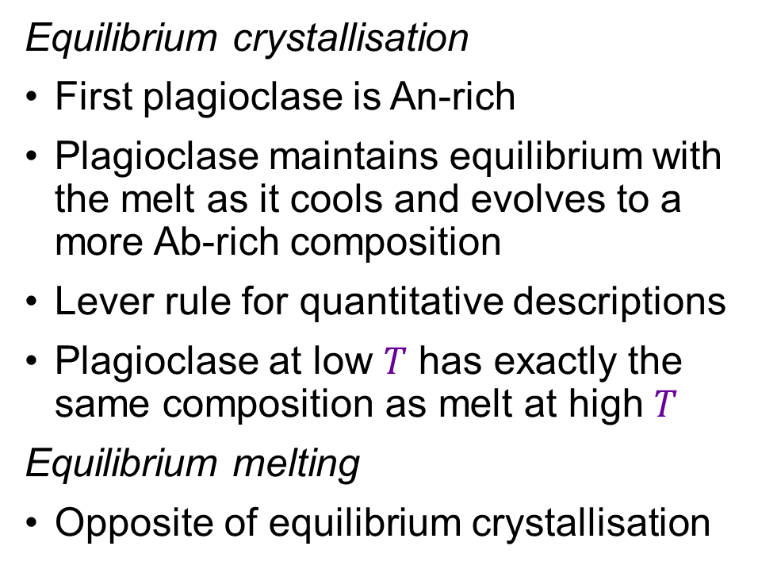
Binary phase diagram with solid solution: plagioclase
Equilibrium crystallisation
First plagioclase is An-rich
Plagioclase maintains equilibrium with the melt as it cools and evolves to a more Ab-rich composition
Lever rule for quantitative descriptions
Plagioclase at low $T$ has exactly the same composition as melt at high $T$
Equilibrium melting
Opposite of equilibrium crystallisation
L
T1
L1
Liquid
System
plag1
T2
L2
a
b
plag2
T3
L3
plag3
plag

Slide 26
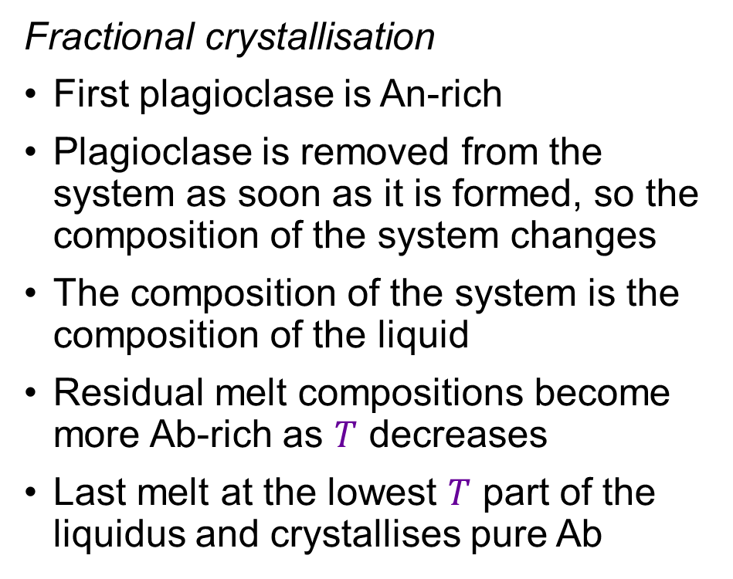
Binary phase diagram with solid solution: plagioclase
Fractional crystallisation
First plagioclase is An-rich
Plagioclase is removed from the system as soon as it is formed, so the composition of the system changes
The composition of the system is the composition of the liquid
Residual melt compositions become more Ab-rich as $T$ decreases
Last melt at the lowest $T$ part of the liquidus and crystallises pure Ab
Liquid
=
System
L
T1
L1
plag1
T2
L2
plag2
T3
L3
plag3
T4
plag4

Slide 27
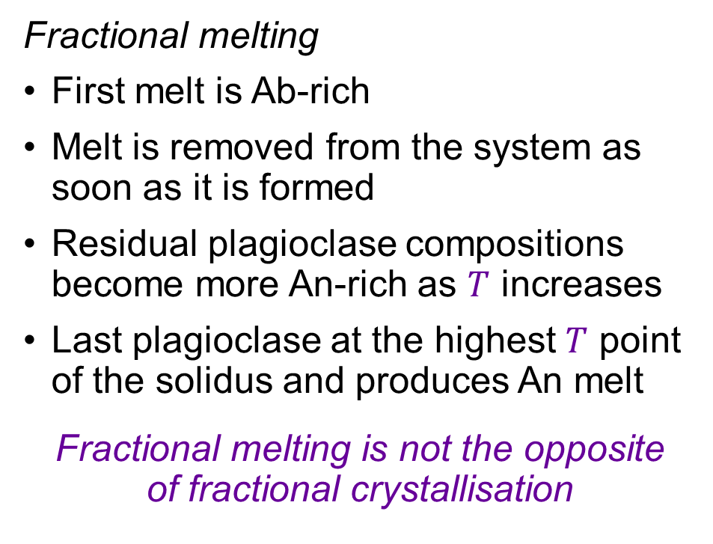
Binary phase diagram with solid solution: plagioclase
L
Fractional melting
First melt is Ab-rich
Melt is removed from the system as soon as it is formed
Residual plagioclase compositions become more An-rich as $T$ increases
Last plagioclase at the highest $T$ point of the solidus and produces An melt
Fractional melting is not the opposite
of fractional crystallisation
T4
L4
T3
L3
T2
L2
plag3
plag2
T1
L1
plag1
plag

Slide 28
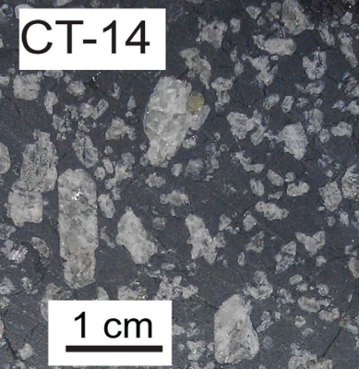
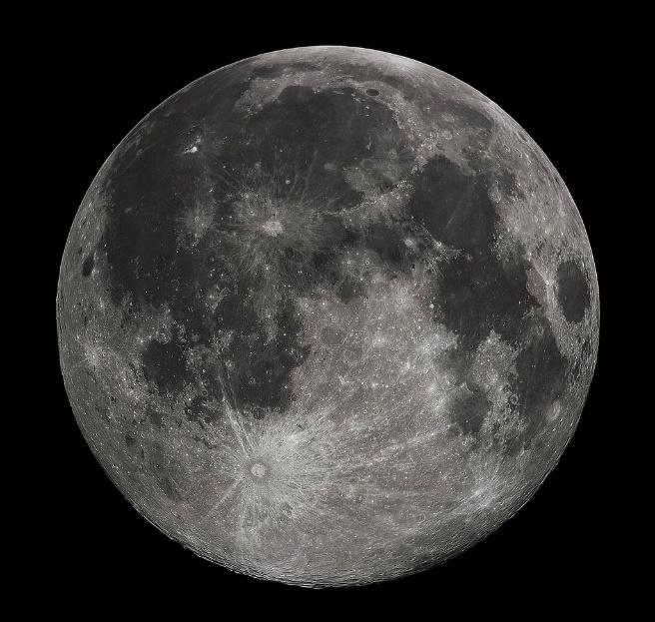
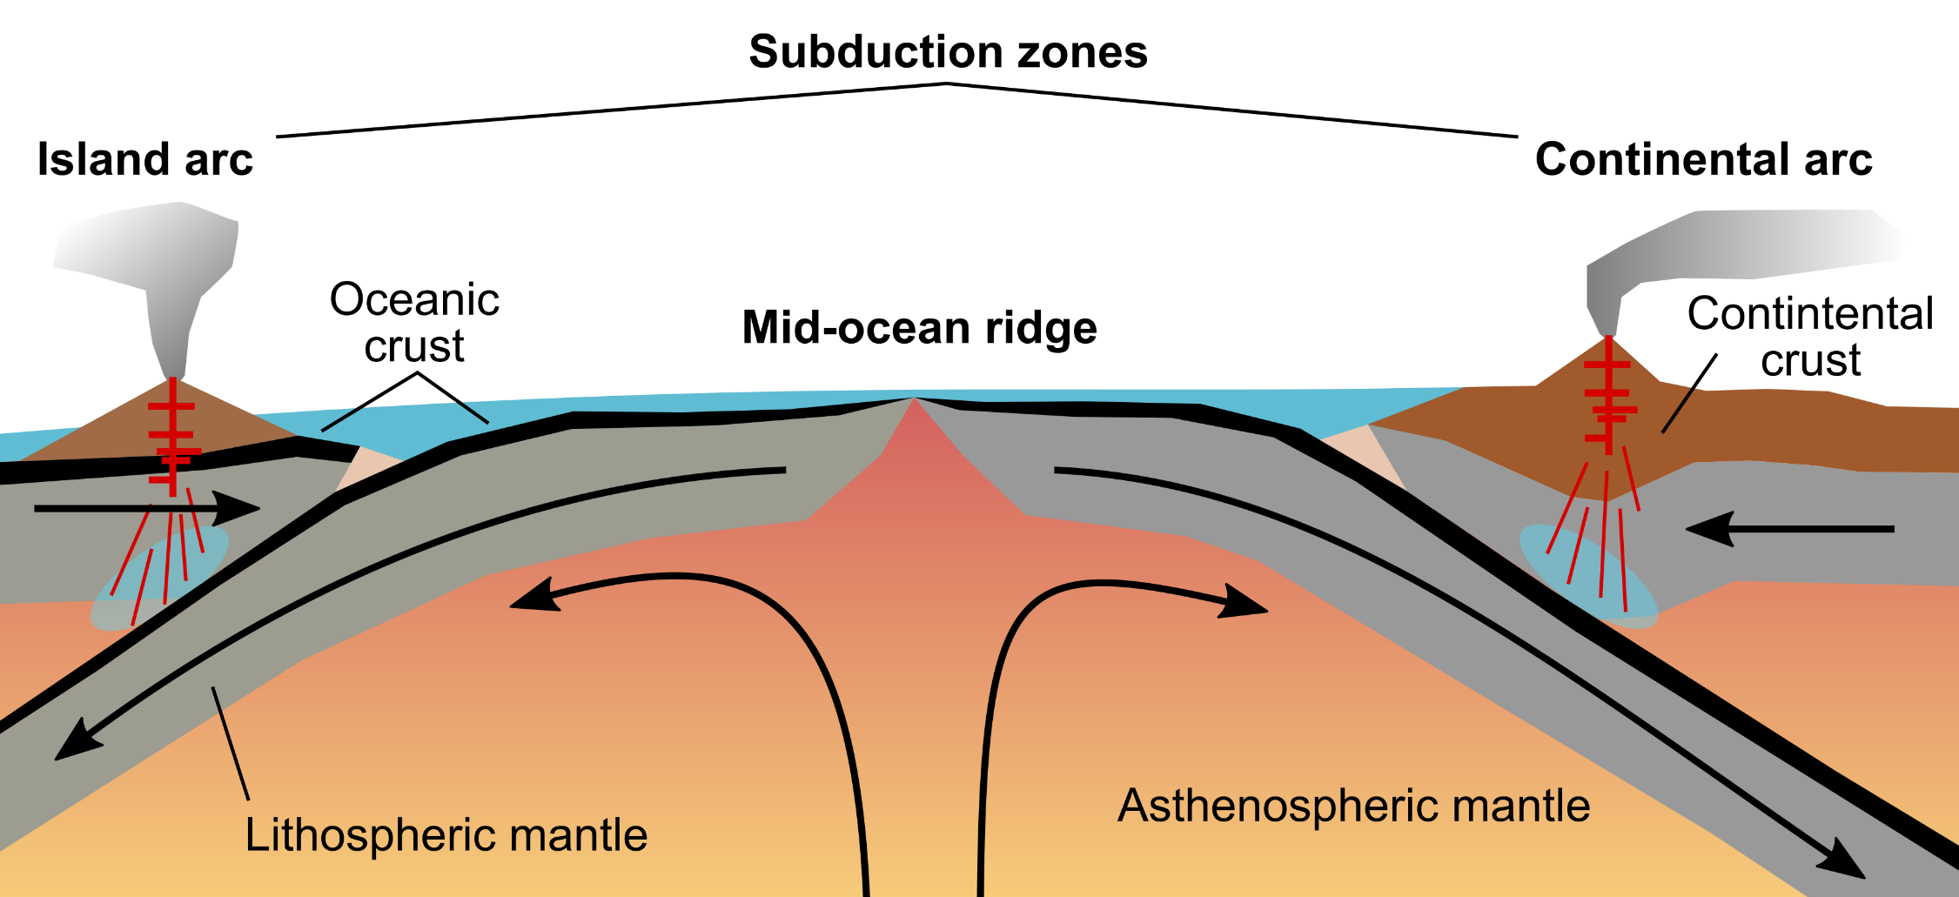
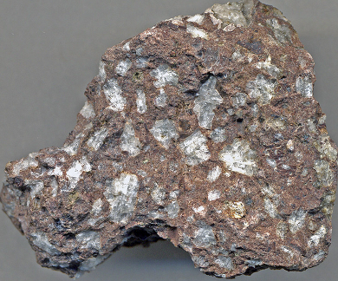
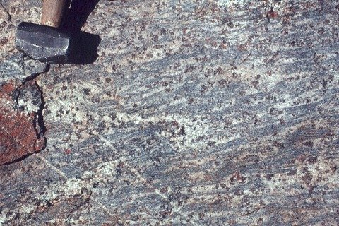
The importance and ubiquity of plagioclase
Oceanic basalt
Lunar Highlands
Lange et al (2013)
Arc andesite
Crustal granulite
credit: James St. John
credit: David Waters

Slide 29
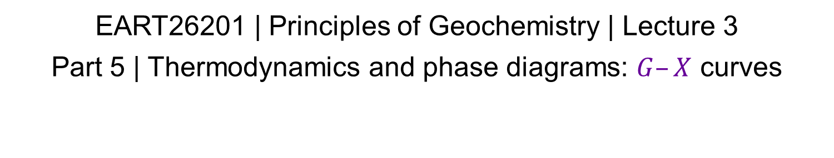
Reactions in geochemical systems: thermodynamics and phase diagram principles
EART26201 | Principles of Geochemistry | Lecture 3
Part 5 | Thermodynamics and phase diagrams: $G–X$ curves

Slide 30
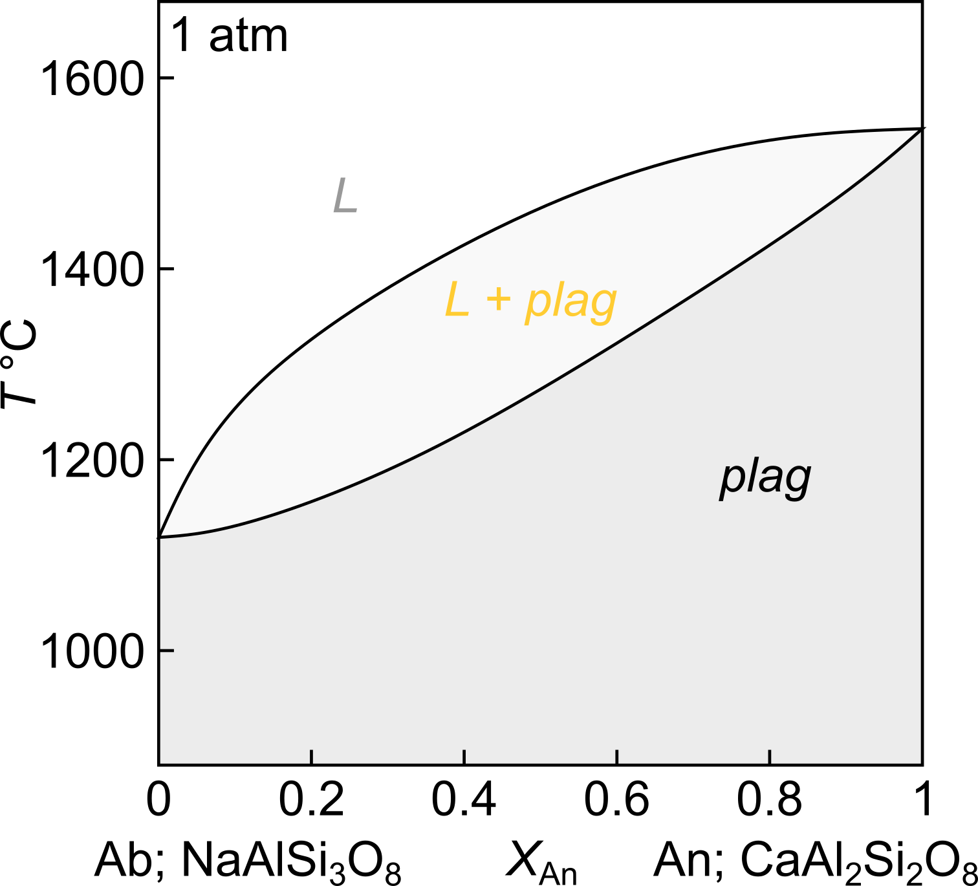

Relating phase diagrams and thermodynamics
Phase diagrams
Relate phase stabilities to intensive variables ($T$, $P$, $X$)
Show which phase (or phase assemblage) has the lowest $G$
Lowest $G$: L only
L and plag
plag only
Thermodynamics concerns equilibrium phases and phase assemblages
We’ll consider kinetics and disequilibrium in Lecture 5

Slide 31




Constructing $G–X$ curves for plagioclase
Mixture has lowest $G$

